Slide 1

LISA ’12:
The Evolution of Ethernet
John D’Ambrosia
Chairman, Ethernet Alliance
(Dell)
jdambrosia@ieee.org
Chauncey Schwartz
Marketing Chair, Ethernet Alliance
(QLogic)
chauncey.schwartz@qlogic.com
Notes:
This presentation is designed to show you the benefits of joining the Ethernet Alliance
We’ll explain our strategic vision and it is actualized in specific goals and events
We’ll show you how your company can participate in the Ethernet Alliance
We’ll show you a little bit of what we did in 2012 and our plans for 2013

Slide 2
Regarding the Views Expressed
The views expressed on IEEE standards and related products should NOT be considered the position, explanation, or interpretation of the Ethernet Alliance.
Per IEEE-SA Standards Board Operations Manual, January 2005:
“At lectures, symposia, seminars, or educational courses, an individual presenting information on IEEE standards shall make it clear that his or her views should be considered the personal views of that individual rather than the formal position, explanation, or interpretation of the IEEE.”

Slide 3
Agenda
Introduction
Building Your Network
The Growth of Ethernet
Ethernet and the Data Center
The Road to Success
Wrap-up
Q&A

Slide 4

How do we tell the story??
Speed ?
Media ?
Deployment ?
Function ?
Application ?
What’s Next ?

Slide 5


Thinking “Cloud” ?
What do I want from “the Cloud”
  The data I want
  The applications I want
  Whenever I want it
  Wherever I want it
  However I want it

Slide 6
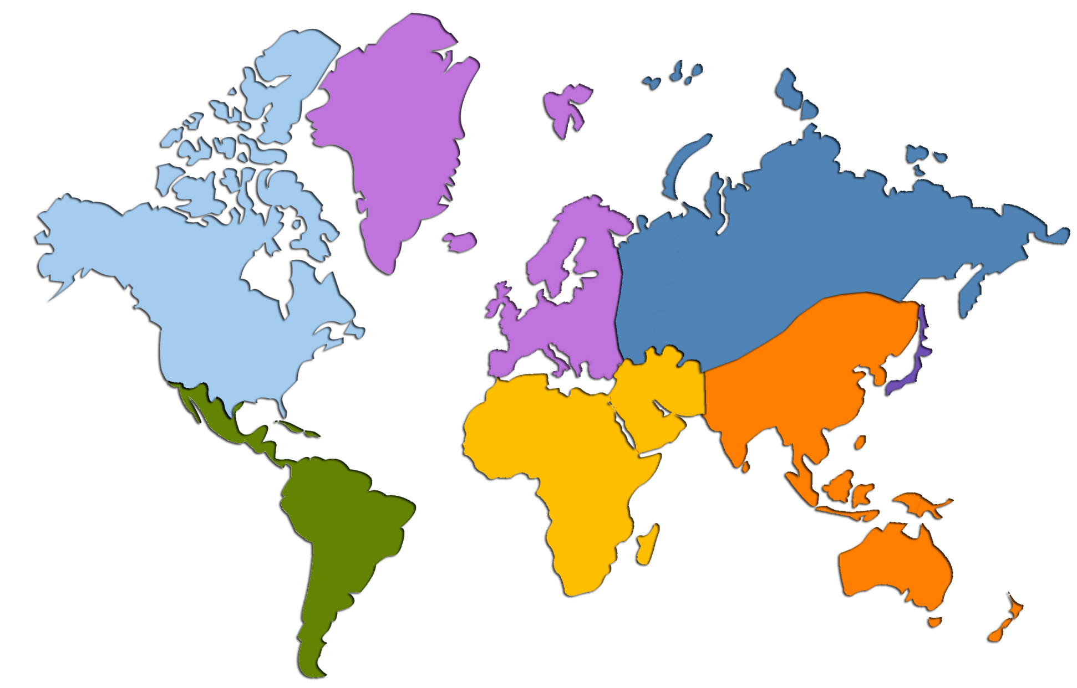
2015 Global Users and Network Connections
North America
Western Europe
Central/Eastern Europe
288 Million Users
2.2 Billion Networked Devices
314 Million Users
2.3 Billion Networked Devices
201 Million Users
902 Million Networked Devices
Japan
116 Million Users
727 Million Networked Devices
Latin America
Middle East & Africa
Asia Pacific
260 Million Users
1.3 Billion Networked Devices
495 Million Users
1.3 Billion Networked Devices
1330 Million Users
5.8 Billion Networked Devices
Source: nowell_01_0911.pdf citing Cisco Visual Networking Index (VNI) Global IP Traffic Forecast, 2010–2015, http://www.ieee802.org/3/ad_hoc/bwa/public/sep11/nowell_01_0911.pdf

Slide 7
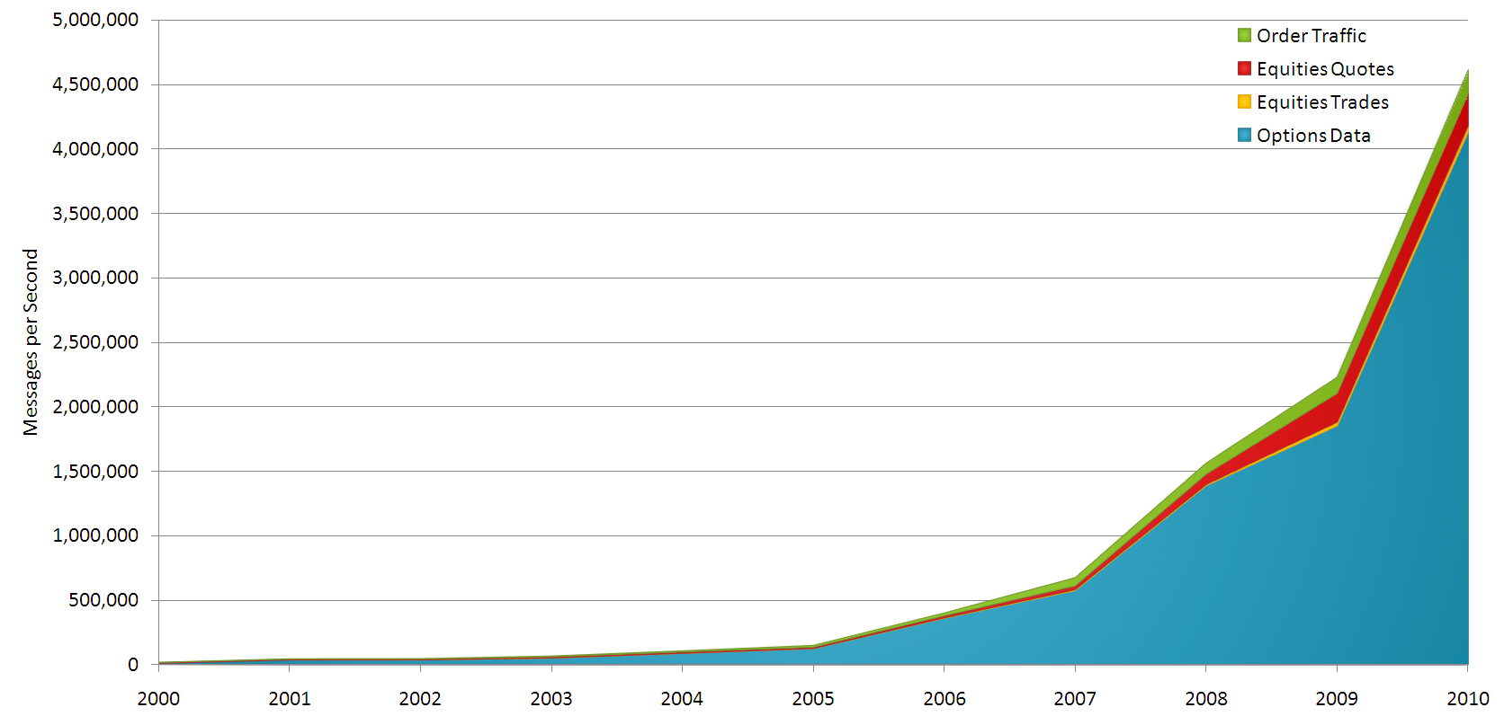
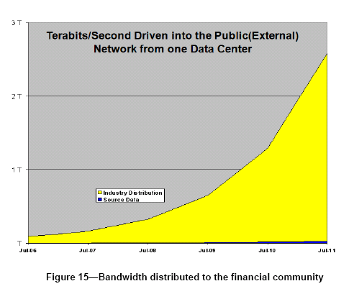
Example: Financial Sector
5 M
Order Traffic Equities Quotes
Equities Trades Options Data
Bandwidth Growth
Messages per second
3T
2T
0
2000
2005
2010
Usage growth
1T
Source Data
Industry Distribution
0
2006
2008
2011
Source: http://www.ieee802.org/3/ad_hoc/bwa/public/jun11/bach_01a_0611.pdf

Slide 8
Growth is throughout the Eco-system
Networking equipment, compute (servers) equipment and storage equipment all required to scale to match application requirements
Source: http://www.ieee802.org/3/ad_hoc/bwa/public/jun11/bach_01a_0611.pdf

Slide 9















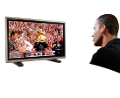


The Equation Remains the Same
Increased #
of
Users
+
Increased Access
Rates and Methods
+
Increased Services
Bandwidth Explosion
Everywhere
=
More Devices
Faster Broadband Speeds
Key Growth Factors
Speed Increasing
YOU
More Internet Users
More Rich Media Content
Source: nowell_01_0911.pdf citing Cisco Visual Networking Index (VNI) Global IP Traffic Forecast, 2010–2015, http://www.ieee802.org/3/ad_hoc/bwa/public/sep11/nowell_01_0911.pdf
Notes:
9
They key IP traffic drivers remain consistent, but each is evolving in new and interesting ways:
First, we have more networked devices and connections: By 2015, we forecast that there will be nearly 15 billion fixed and mobile networked devices and machine-to-machine connections. That’s more than two devices for every person on earth by 2015—the United Nations projects that there will be 7.2 billion people by 2015. There are a plethora of new and enhanced devices; from tablets and smartphones to web-enabled TVs and multifunction gaming consoles; that residential, mobile and business users are adopting and using more and more.
Secondly, we’ve got more users: As fixed and mobile networks grow and expand, more of the world’s population will have network and Internet access. By 2015, there will be 3 billion Internet users.
Third, we’ll see faster fixed broadband speeds: More network speed leads to more high-bandwidth computing and network usage because you have a better, more efficient experience. We expect fixed broadband speeds to grow 4-fold from 2010 to 2015—from a global average of 7 megabits per second to 28 megabits per second.
And finally, rich media and video will continue to dominate our online experiences: Every second, one million minutes of video content will cross the global network in 2015.
Let’s take a look at a few of these key traffic catalysts in a bit more detail. There are several interesting trends that are particularly noteworthy…

Slide 10
Metcalfe’s Law
The value of a telecommunications network is proportional to the square of the number of connected users of the system
Ethernet
Benefits
Any where
Any time
Any way
Challenges
Developing it
Deploying it
Managing it

Slide 11

The World is Your Network And
Ethernet
Connects It

Slide 12
Building your network
Ethernet’s Building Blocks

Slide 13

What’s Your Network Concern?
Network Concerns?
  Enterprise?
  Data Center?
  Metro?
  Carrier?
  Wireless?
  Wi-Fi?
  Automotive?
Ethernet is everywhere!

Slide 14
One Size Doesn’t Fit All Anymore
Industry challenges
  Market Need
  Increasing Bandwidth
  Technical Feasibility
  Lowering Cost per bit!
Think “Big”
  Scaling
  Economics of applications will dictate solutions!
  Connecting everyone, everywhere, all the time!
1,000,000
100,000
100 Gigabit Ethernet
Core Networking Doubling ≈18 mos
40 Gigabit Ethernet
10,000
10 Gigabit Ethernet
Rate Mb/s
1,000
Gigabit Ethernet
Server I/O Doubling ≈24 mos
100
1995
2000
2005
2010
2015
2020
Date
Why was
40GbE and 100GbE developed?

Slide 15
IEEE 40Gb/s and 100Gb/s:
Currently Defined Physical Layer Specifications
Media | PHY name | Description | 40G | 100G
Backplane | 40GBASE-KR4 | At least 1m backplane | 4x10G Parallel
Cu Cable | 40GBASE-CR4 100GBASE-CR10 | At least 7m cu (twin-ax) cable | 4x10G Parallel | 10x10G Parallel
Multimode Fiber | 40GBASE-SR4 100GBASE-SR10 | At least 100m OM3 MMF (150m OM4 MMF) | 4x10G Parallel | 10x10G Parallel
Single Mode Fiber | 40GBASE-FR | At least 2km SMF | 40G Serial
 | 40GBASE-LR4 100GBASE-LR4 | At least 10km SMF | 4x10G WDM | 4x25G WDM
 | 100GBASE-ER4 | At least 40km SMF |  | 4x25G WDM

Slide 16
Growing the 100GbE Family
Media | PHY name | Description | 40G | 100G
PCB Traces | CAUI | Chip-to-chip and chip-to-module interfaces |  | 4x25G Parallel
Backplane | 100GBASE-KR4 100GBASE-KP4 | NRZ-based PHY PAM-4 based PHY |  | 4x25G Parallel
Cu Cable | 100GBASE-CR4 | At least 5m cu (twin-ax) cable (NRZ) |  | 4x25G Parallel
Twisted Pair | To be determined | To be determined | √
MMF | 100GBASE-nRx | At least 20m MMF At least 100m MMF |  | 4x25G Parallel
SMF | 40GBASE-nRx | At least 40km SMF | 4x10G WDM
 | 100GBASE-nRx | At least 500m SMF |  | ?

Slide 17
Forecast: 2015: Terabit! 2020:10 Terabit!
Source: IEEE 802.3 Ethernet Bandwidth Assessment, http://www.ieee802.org/3/ad_hoc/bwa/BWA_Report.pdf.

Slide 18
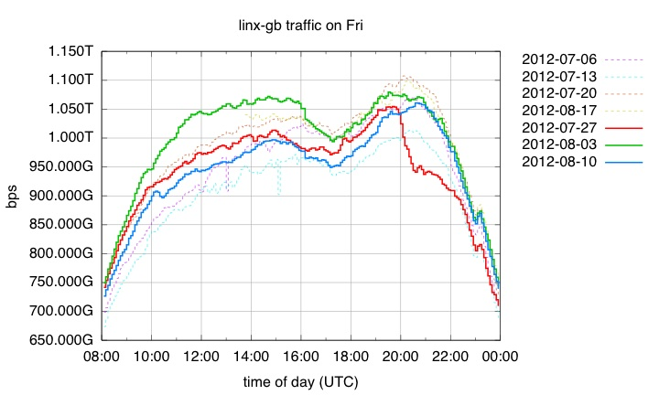
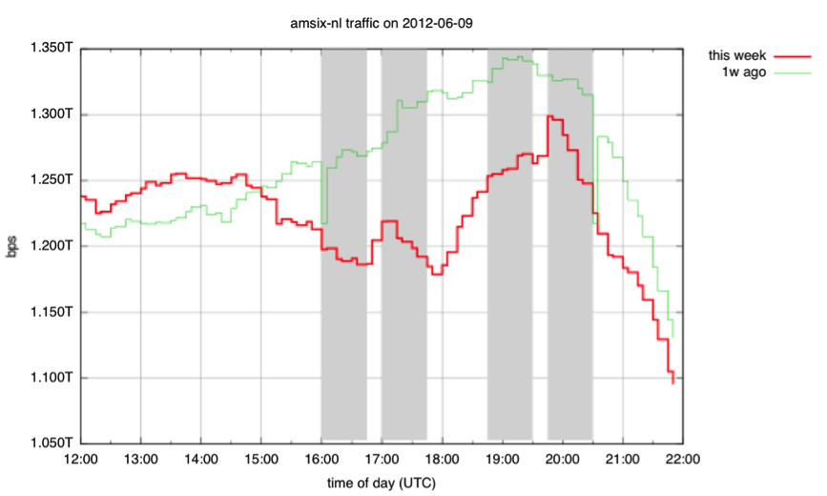
The Future is Here
2012 Summer Olympics
After First Round of Euro 2012 Matches
Source: https://labs.ripe.net/Members/fergalc/internet-traffic-during-olympics-2012
Source: https://labs.ripe.net/Members/fergalc/internet-traffic-after-first-round-of-euro-2012-matches/AMSIXNL.png
Thanks to Bijal Sanghani, Euro-IX.

Slide 19
Backplane
V.G. Copper
Twisted Pair
Twin-Ax
Co-axial
Key:
Rate (b/s)
MMF
SMF
PON
Chip-to chip/module
1T
Backplane
Future CFI?
Twin-axial
100G
Multimode Fibre
40G
Voice grade copper
10G
Co-axial
Twisted pair
1G
Reduced Twisted pair
Single-mode Fibre
100M
Point to Multipoint Fibre
Power Over Ethernet
10M
Co-axial Network
Open Circle indicates development effort
Distance channel model dependent
1M
DC
0.1
1
10
10²
10³
10⁴
10⁵
Distance (m)
Based on slide used by permission from David Law

Slide 20
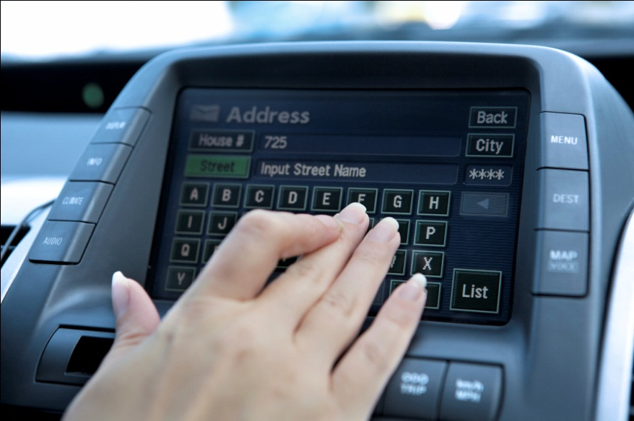
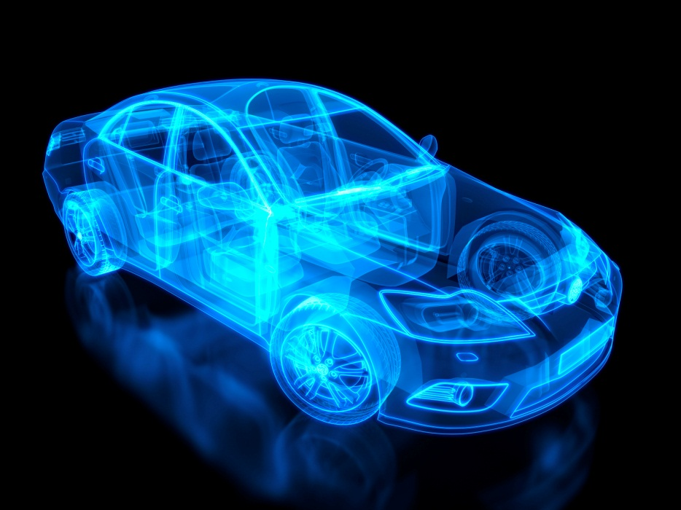
Ethernet’s Expanding Eco-system
Formation of IEEE P802.3bp RTPGE Task Force
GbE for Automotive!
By 2019 – nominal estimate: 300 M ports per year
What new services will be introduced?
What will this mean to you?

Slide 21
The Growth of Ethernet

Slide 22
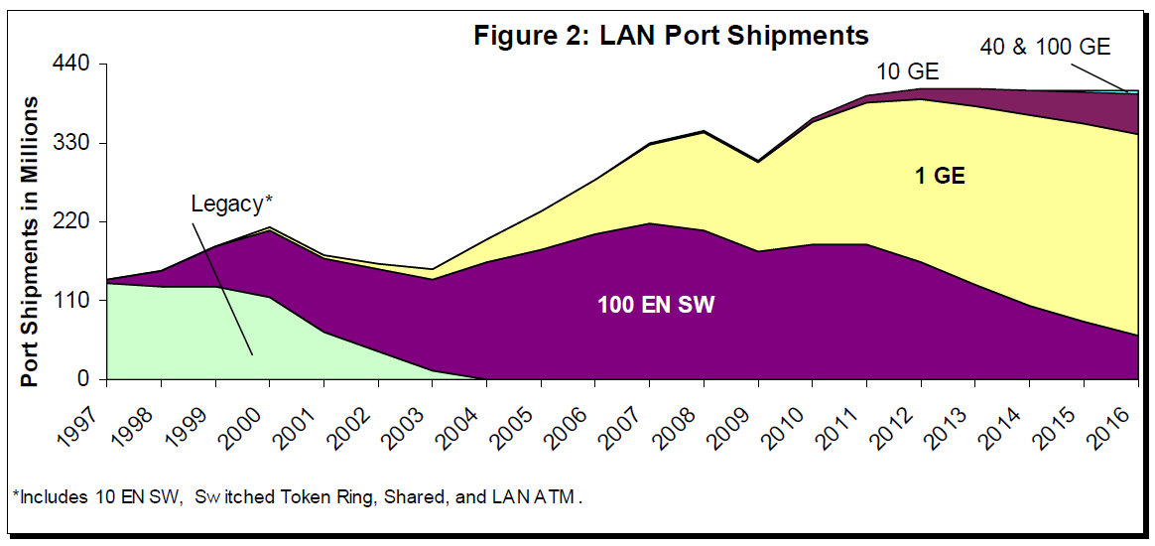
Ethernet Port Shipments
Over 400 Million Ports shipped in 2012 for the first time!
Source: Dell’Oro Ethernet Switch Forecast Report, July 2012

Slide 23
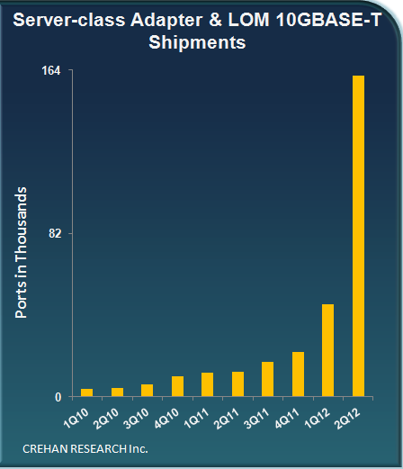
The 10GbE Server Market Looks Bright!
All data used with permission Seamus Crehan, Crehan Research.

Slide 24
External Storage Shipments
Growth over Next Decade
# of Servers | x10
Storage | x50
# of Files | x75
Entered the Zettabyte Era
Consider
the
implications!
Source: http://www.ieee802.org/3/ad_hoc/bwa/public/sep11/kipp_01a_0911.pdf

Slide 25
Global IP Traffic by
Local Access Technology
Source: nowell_01_0911.pdf citing Cisco Visual Networking Index (VNI) Global IP Traffic Forecast, 2010–2015, http://www.ieee802.org/3/ad_hoc/bwa/public/sep11/nowell_01_0911.pdf

Slide 26
Data Center Growth
Networking
Entered the 100GbE era in 2010
Individual switches have Tb/s of bandwidth
Compute
First petaflop supercomputers in 2011
Individual servers delivering 10s of Gb/s of I/O
PCIe 3.0 supports 2 x 40GbE NICs now
Storage
Entered the zettabyte (1 billion terabytes) era in 2010
Individual disk drives over 1 terabyte
1000 disk drive storage subsystem equals 1 Petabyte
ETHERNET: The Progression of Plug-n-Play

Slide 27

Ethernet and the data center

Slide 28
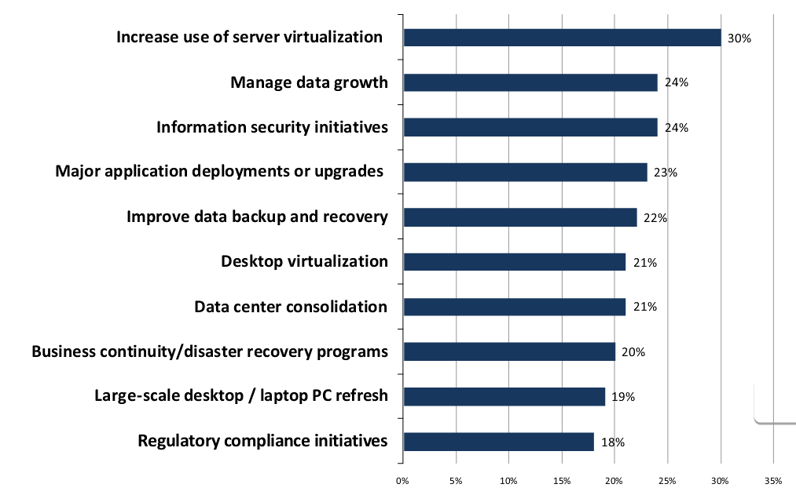
Top IT Initiatives
Source: 2010 ESG Research

Slide 29
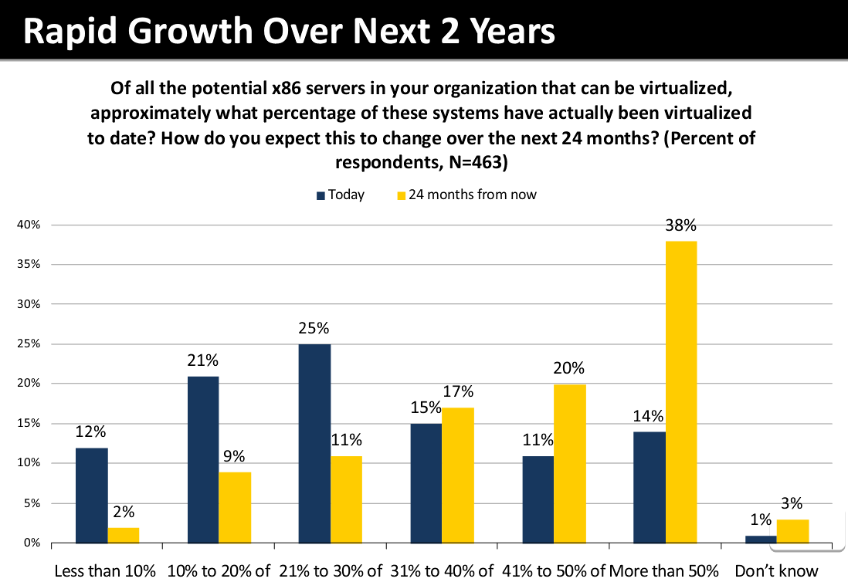
Server Virtualization – Driving the data center evolution
86%
of servers workloads will be virtualized by 2018
85% in 2018
65% in 2010
Source: Gartner
Source: ESG Research

Slide 30
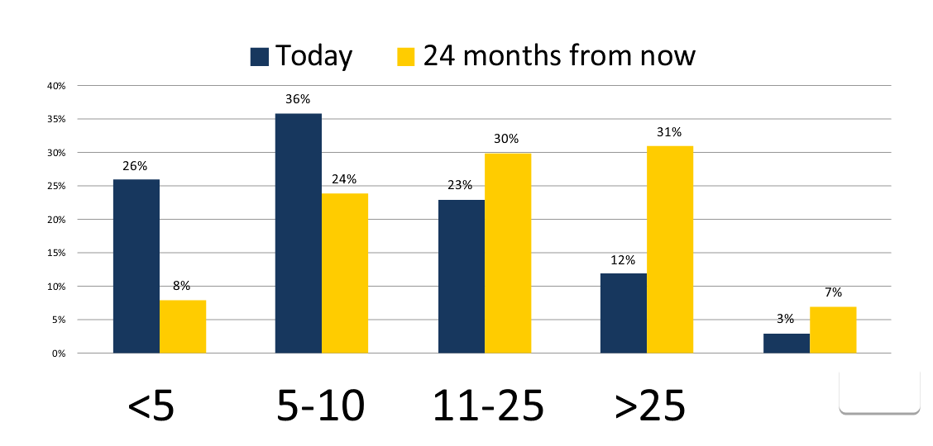
VM density drives I/O demand which drives Network Innovation
40GbE
10GbE
Virtual Machine density: Number of VMs deployed per physical server
Source: ESG Research

Slide 31

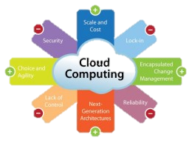
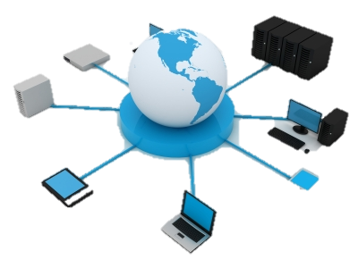

10Gb Ethernet Solutions in the Data Center
Consolidation
Optimizing data
center resources
Virtualization
Increasing resource
utilization, availability
and agility
Convergence
Unified data
center fabric
Cloud
Completing
the journey
Data Center Evolution

Slide 32
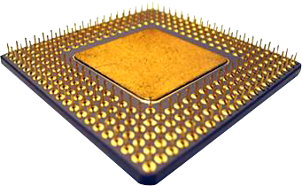



All Roads Lead to Ethernet for Data Center I/O
Networking
File
Storage
iSCSI
HBA
Fibre Channel
HBA
InfinBand
HCA
InfiniBand
Ethernet
Ethernet
Ethernet
Ethernet
Ethernet
[iWarp]
LAN
NAS
SAN
SAN
Low Latency
Used with Permission from Pat Thaler, Broadcom.

Slide 33

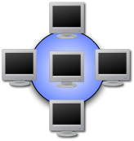





Today’s Environment
Separate networks for each traffic type
  LAN, SAN, IPC
Unique infrastructure
  Server adapters
  Fabric switches
  Cables
Separate management schemes
Inherently costly and complicated
LAN
SAN
IPC
Notes:
In today’s datacenter, you’ll find separate network infrastructure installed to serve different networking needs. For instance, you’ll commonly find an Ethernet network to support LAN, a Fibre Channel network to support SAN, and an InifiniBand network for IPC, or inter-processor communication, to support clustering.
This naturally increases data center capital expenses by requiring separate server adapters, fabric switches, and cabling, as well as increasing operating expenses in terms of increased power, cooling, and management costs. This has driven a movement to reduce data center costs through network convergence.

Slide 34
What is Data Center Bridging?
Terminology
  Enhanced Ethernet
  Datacenter Ethernet
  Converged Enhanced Ethernet
Lossless vs. lossy
  Ethernet = Lossy (expected to “drop” packets when busy)
  Fibre Channel = Lossless (expected to not lose information)
  SCSI does not recover quickly from lost packets
Enhanced Ethernet is lossless
  New features have been added to prevent dropped packets
  Better suited for transporting SCSI traffic
Notes:
Enhanced Ethernet (aka Datacenter Ethernet or Converged Enhanced Ethernet) is an umbrella name referring to a set of feature enhancements that have been added to the Ethernet specification. The main goal of these Enhanced Ethernet features is to make Ethernet more suitable to carry SAN traffic.
Standard Ethernet is a “lossy” networking medium. This means that when a network is very busy and a switch becomes congested (i.e. switch buffers become full), Ethernet spec allows the switch to drop Ethernet frames. These dropped frames are detected by upper layer networking protocols (such as TCP in most LAN networks) and are re-transmitted. This is perfectly acceptable behavior and occurs all the time in today’s Ethernet LAN networks without an actual user ever noticing. However, while this is acceptable for most LAN traffic, this behavior is not acceptable for SAN traffic.
SCSI protocol was developed in the early 1980’s and was originally intended for direct connection between a SCSI controller and a SCSI device. It wasn’t designed to support a networked architecture and didn’t expect to experience dropped packets. Therefore, SCSI doesn’t recover quickly from lost packets-meaning there could be significant performance degradation in a busy Ethernet network.
Fibre Channel has become the standard for SAN networks because it was designed to be “lossless”. That means it has implemented a mechanism to prevent packets from being dropped, even in a busy environment. This lossless nature is perfectly suited to transporting SCSI traffic.
Enhanced Ethernet, therefore, has added features to the standard Ethernet spec regarding lossless behavior. While it is already possible to make Ethernet a lossless network through use of the “PAUSE” function made available in the 802.3X specification, it is rarely implemented. The features enabled by Enhanced Ethernet add sophistication and additional control to Ethernet’s pause behavior – which makes Ethernet better suited for transporting SCSI traffic.

Slide 35
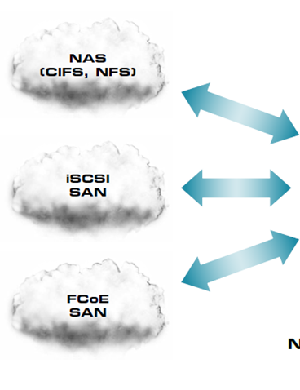

Data Center Bridging (DCB) enables converged networks
IP
iSCSI
10GbE
FCoE
Simultaneous NAS, iSCSI,
FC/FCoE
Standards Done!
IEEE 802.1Qaz: Enhanced Transmission Selection (ETS)
IEEE 802.1Qbb: Priority-based Flow Control (PFC)
IEEE 802.1Qau: Congestion Notification

Slide 36
Data Center Bridging Standards
Pause IEEE 802.3X – defines link level flow control and specifies protocols, procedures and managed objects that enable flow control full‐duplex Ethernet links to prevent lost packets
Priority Flow Control (PFC) IEEE 802.1Qbb – enhances pause mechanism to achieve flow control of 8 traffic classes by adding priority information in the flow control packets (http://www.ieee802.org/1/files/public/docs2008/bb-pelissier-pfc-proposal-0508.pdf)
Enhanced Transmission Selection (ETS) IEEE 802.1Qaz – assigns traffic classes into priority groups and manages bandwidth allocation and sharing across priority groups (http://www.ieee802.org/1/files/public/docs2008/az-wadekar-ets-proposal-0608-v1.01.pdf)
Data Center Bridging Exchange Protocol (DCBX) IEEE 802.1Qaz – “Advertisement/configuration” to allow devices to automatically exchange DCB link capabilities (http://www.ieee802.org/1/files/public/docs2008/az-wadekar-dcbx-capability-exchange-discoveryprotocol-1108-v1.01.pdf)
Congestion Notification (CN) IEEE 802.1Qau – allows bridges to send congestion signals to end-systems to regulate the amount of network traffic
Notes:
[comments] verbally speak to PAUSE 802.3x. DCB slide title is incorrect…(Pause (802.3x) – Stop transmission when queue is full (prevent lost packets)). Alternatively, make a sub-bullet under PFC. Action item: Chauncey
[comments] potentially replace “handshake” with “advertisement/configuration”. Action item: Chauncey

Slide 37
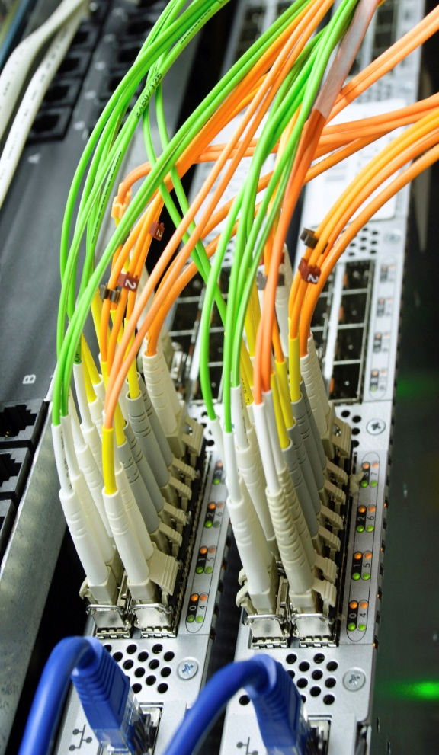
Quick reminder on Data Center Bridging
Unifying I/Os and networks over Ethernet
Enhanced switches to support lossless Ethernet
Essentially, improved Ethernet that is suitable for data center applications
Use cases support multiple storage protocols and LAN, and high performance computing

Slide 38

Deployment Process
Today: Not Converged
  Separate NIC & HBA
Step 1: Converged edge
  DCB adapters
  DCB “top of rack” switch
Step 2: Converged core
  Expanded converged
  network
  Native attach storage
Goal: Converged
network
  Multiple storage
  technologies over Ethernet
Process Benefit: Provides the building blocks to upgrade
a portion of or all data center network assets into a
converged infrastructure
Notes:
[comments] removed “no rip & replace” with “phased upgrade”. Action item: Chauncey to review the new text.
[comments] update icons. Not clear if it’s meant to show “computer-to-computer”? Action item: Jason (NetApp) to help with graphic. Henry to send slide to Jason.
[comments] “converged core” bullet needs some work/feedback. Action item: all who has comments on this slide please send comments directly to Chauncey/Henry. Henry to send slide to those interested in providing feedback.
One of the strengths of FCoE is that it protects existing investment in LAN and FC SAN infrastructure. End users who migrate to an FCoE network can do so in stages, rather than requiring a datacenter “forklift”.
The typical datacenter today has installed a separate LAN & SAN infrastructure which utilizes separate, unique server adapters and fabric switches.
<Advance slide animation…one click>
Most initial FCoE deployments will start at the network’s edge by installing CNAs which connect to a “top of the rack” FCoE switch. The “top of the rack” switch is so named because it is meant to be installed in a server rack and provides fabric access to the servers within that and adjacent racks. The Cisco Nexus 5020 and Brocade 8000 are examples of “top of the rack” FCoE switches. One advantage to this approach is that it allows the end user to connect their CNAs to their FCoE switches using inexpensive copper cabling, as opposed to a more expensive optical solution that enables longer distance reach. In this configuration, the FCoE switch is responsible for translating between FCoE signaling and native FC signaling. FCoE packets from the CNA have their Ethernet header/footer removed by the FCoE switch before passing the original FC frame to the native FC fabric. Going in the other direction, the FCoE switch adds the appropriate Ethernet header/footer to native FC packets sent from the Fibre Channel array and intended for the CNA. One nice thing about this approach is that the end user can migrate to an FCoE network in stages by adding CNAs and FCoE switches at the network edge and maintaining their existing LAN and FC SAN infrastructure.
<Advance slide animation…one click>
As FCoE adoption increases, FCoE networks will start expanding into the core of the data center network. Over time, native FCoE storage will become more popular, meaning that FCoE frames will travel unaltered from the CNA at the network’s edge all the way to the storage array. NetApp has already announced native FCoE storage (utilizing QLogic FCoE technology) and other vendors are expected to announce similar FCoE native storage products throughout 2010 & 2011.

Slide 39
Enhanced Transmission Selection (ETS)
Standards
Industry
IEEE 802.1Qaz
  Approved as IEEE standards in June 2011
Many switch, adapter and chipset vendors
  Switch vendor support
Interoperability
  Not applicable
    See DCBX interoperability
  Local forwarding decision
  Works well end-to-end across different vendors

Slide 40
Data Center Bridging eXchange (DCBX)
Standards
Industry
Pre-standard
  Convergence Enhanced Ethernet (CEE)
IEEE P802.1Qaz
  Approved as IEEE standards in June 2011
Many switch, adapter and chipset vendors
Interoperability
  Most venders support
  CEE 1.01
    Highly interoperable
  Few venders support IEEE 802.1Qaz today
    Most have roadmap to support this in near future

Slide 41
Congestion Notification
Standards
Industry
IEEE 802.1Qau
  Approved as IEEE standards in 2010
Very few support
Few have roadmap in the near future
Interoperability
  Limited early interoperability testing fall 2010
  More testing planned

Slide 42

Road to Success
Testing, testing, and more testing

Slide 43
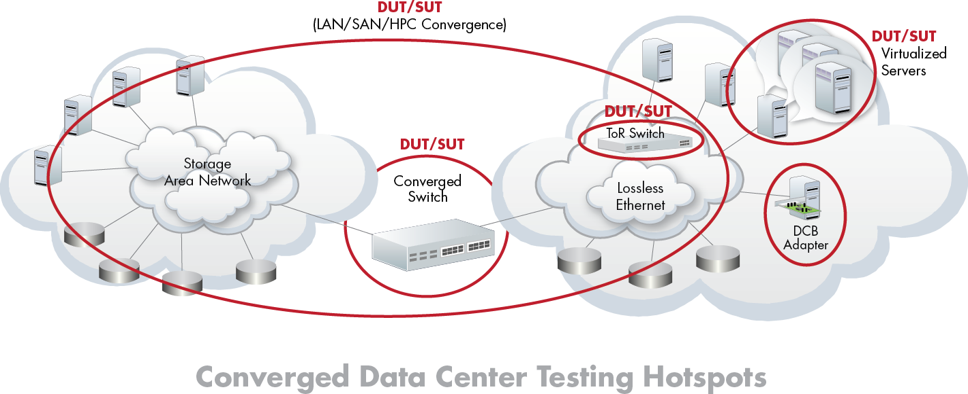
A lot to test in the Converged Data Center
DCB protocols, FCoE/iSCSI/RoCE /iWARP applications, converged switches, DCB adapters, Bridging protocols, Routing protocols, 40/100GbE uplinks, virtualization performance

Slide 44

Ethernet Alliance Testing end-to-end
EA Plugfest converged network testing
FCoE/iSCSI/iWARP/RoCE
Data Center Bridging
Storage + TCP/IP
CNA
Virtualization
Storage testing
I/O performance
Server performance
Fibre Channel
Network testing
TCP/IP performance
Switch performance
Ethernet
Ethernet Alliance facilitates multi-vendor PlugFests at
University of New Hampshire Interoperability lab
to validate end-to-end converged network functionality.

Slide 45
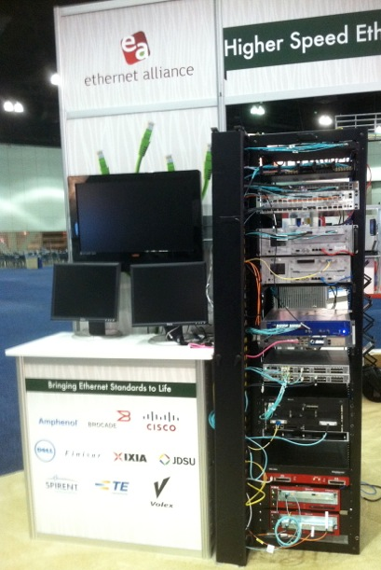
Interoperability Demonstrations
OFC 2012: From the Cloud to the Data Center
  Optical Technologies Featured
    100 GbE over OTN
    100 GbE (100GBASE-LR4)
    40 GbE
    40 GbE to 4 x 10 GbE Breakout
    10 GbE
http://www.ethernetalliance.org/wp-content/uploads/2012/02/EA_OFC12_press-release.pdf
Interop Las Vegas 2012
  Ethernet’s data center support
    Cloud computing
    Convergence
    Virtualization
  Featured
    40 GbE
    10 GbE
http://www.ethernetalliance.org/wp-content/uploads/2012/05/EA_PressRelease_Interop_FINAL-050112-2.pdf
© 2012 Ethernet Alliance

Slide 46
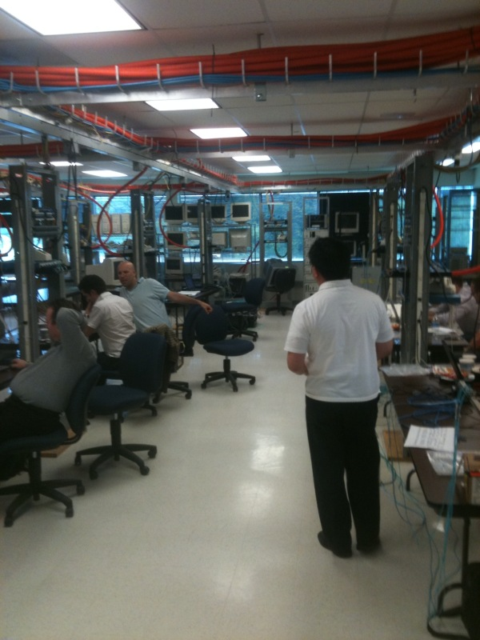
TeraFabric Plugfest 2012
When: Oct 22 – 26, 2012
Where: Univ. of New Hampshire, Interoperability Laboratory
18 companies participated
Testing Included
  Data Center Bridging
  10GBASE–T
  10G/40G Ethernet DCB network
  Terabit capable fabric with 18 vendors interoperating
  http://www.ethernetalliance.org/wp-content/uploads/2012/10/EA_Terafabric_media-alert_FINAL_101712.pdf
© 2012 Ethernet Alliance

Slide 47
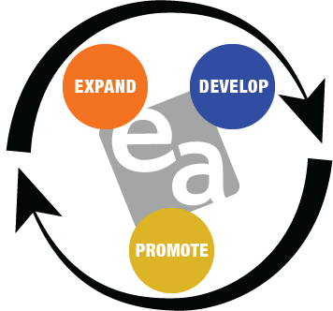
THE ETHERNET ALLIANCE
A global community of end users, system vendors, component suppliers and academia
  Mission
    Promote existing and emerging IEEE 802 Ethernet standards
    Accelerate industry adoption
    Demonstrate multi-vendor interoperability
  2012 Strategic Priorities
    Demonstrating Interoperability
    Industry Consensus Building
    Global Expansion
    Marketing & Education
    The Voice of Ethernet

Slide 48
Reaching Consensus
Myth: The IEEE makes the decisions
Reality: The IEEE is a forum for the industry to make the decisions
Any standards development effort might include these (and others):
End users
Equipment Vendors
Chip Vendors
Optics Vendors
Cable Suppliers
Connector Vendors
Test Equipment Vendors
PCB Materials Vendors
PCB Mfg. and Assembly Vendors
Consultants
In the IEEE technical decisions require > 75% consensus
What is the industry consensus?

Slide 49
The Ethernet Alliance
The Voice of Ethernet
For more information visit: www.ethernetalliance.org;
Follow @EthernetAllianc on Twitter
Join the Ethernet Alliance LinkedIn group
Visit the Ethernet Alliance Facebook page
Questions? Contact:
  Morgan Fricke – Director of Operations
    morgan@ethernetalliance.org
  John D’Ambrosia – Chairman of the Board
    Chair@ethernetalliance.org

Slide 50

Discussion and Q&A

