Slide 1
The Ethernet Roadmap PAnel
Scott Kipp
March 15, 2015

Slide 2
Agenda
11:30-11:40 – The 2015 Ethernet Roadmap – Scott Kipp, Brocade
11:40-11:50 – Ethernet Technology Drivers - Mark Gustlin, Xilinx
11:50-12:00 – Copper Connectivity in the 2015 Ethernet Roadmap - David Chalupsky, Intel
12:00-12:10 – Implications of 50G SERDES Speeds on Ethernet speeds - Kapil Shrikhandre, Dell
12:10-12:30 – Q&A

Slide 3
Disclaimer
Opinions expressed during this presentation are the views of the presenters, and should not be considered the views or positions of the Ethernet Alliance.

Slide 4
The 2015 Ethernet Roadmap
Scott Kipp
March 15, 2015

Slide 5
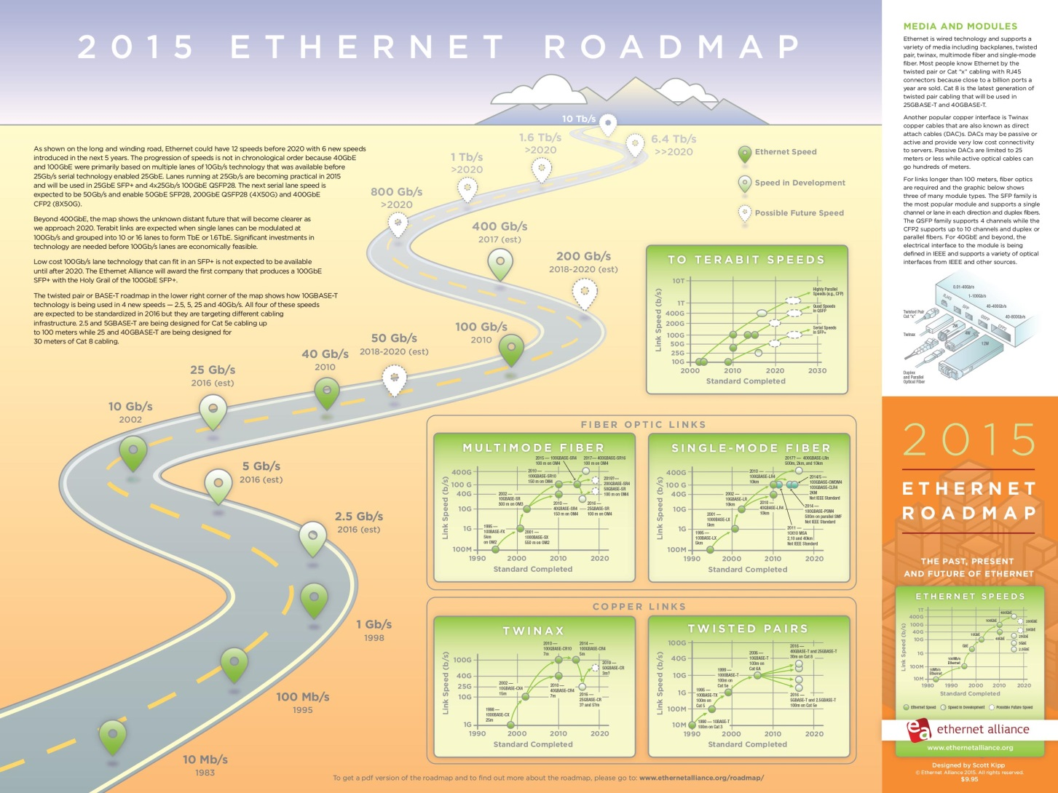

Slide 6
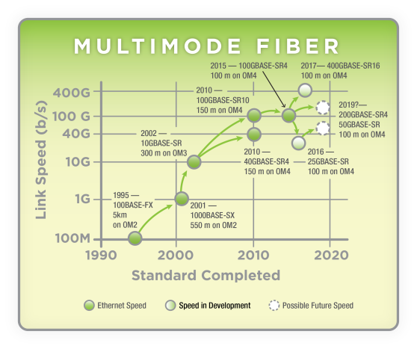
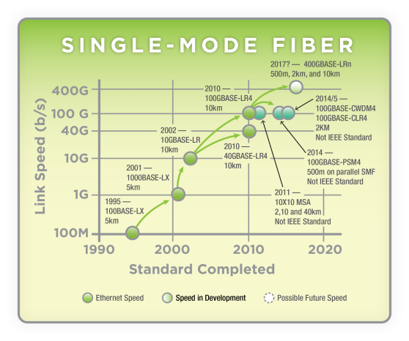
Optical Fiber Roadmaps

Slide 7
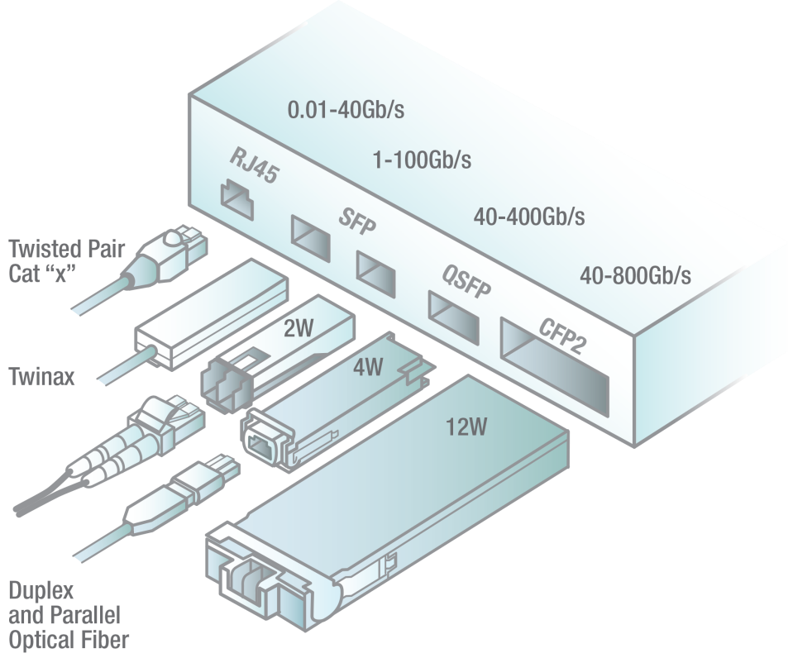
Media and Modules
These are the most common port types that will be used through 2020

Slide 8
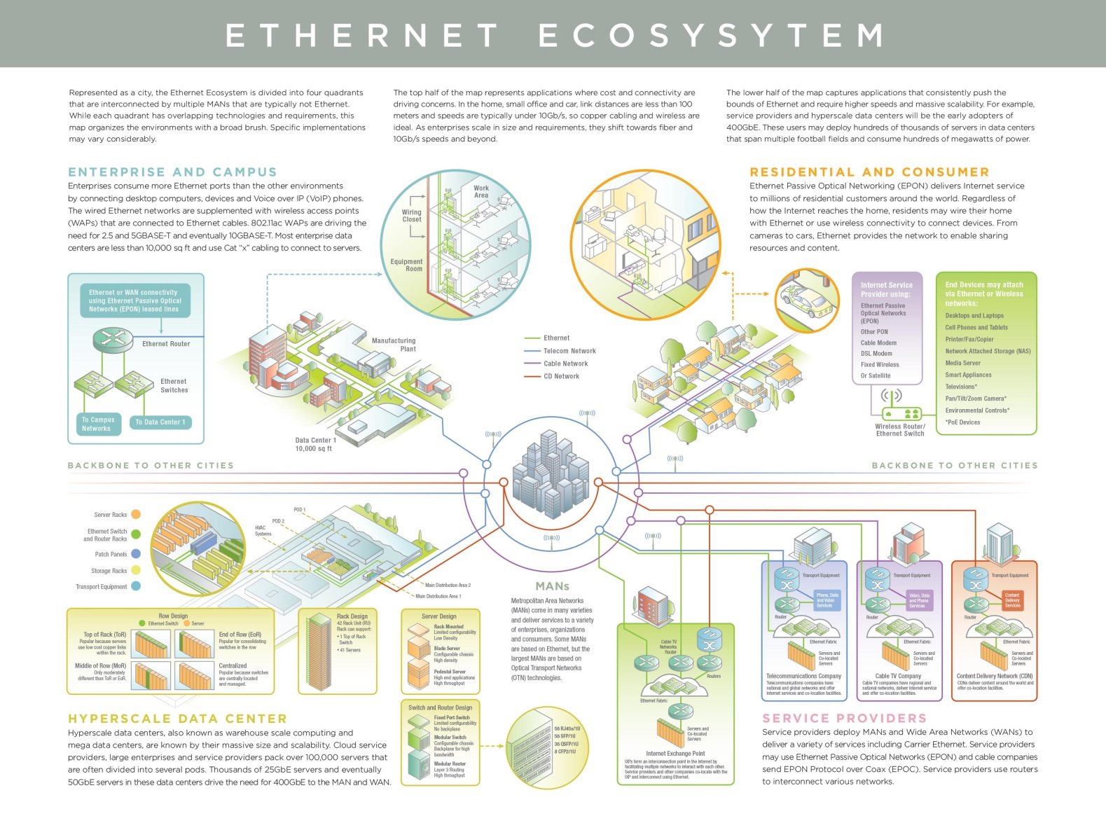

Slide 9
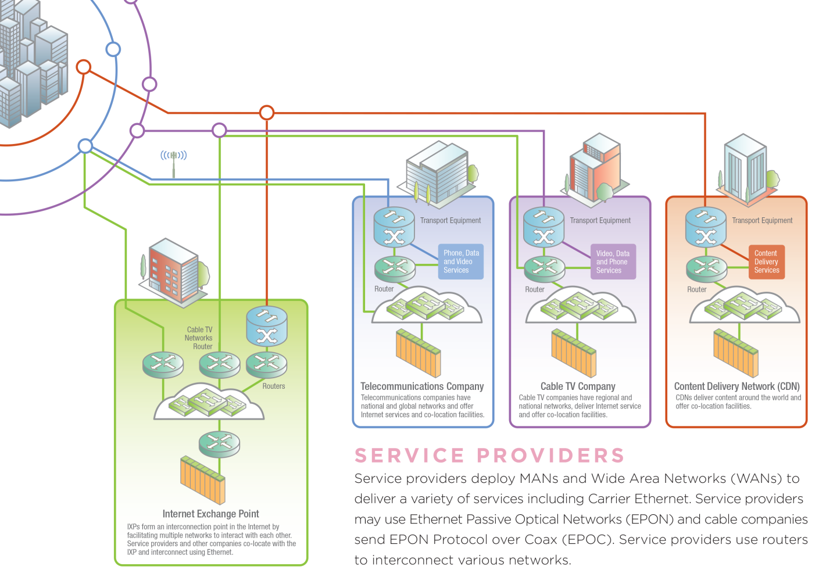
Service Providers

Slide 10
More Roadmap Information
Your free map is available after the panel
Free downloads at www.ethernetalliance.org/roadmap/
  Pdf of map
  White paper
  Presentation with graphics for your use
Free maps at Ethernet Alliance Booth #2531

Slide 11
Ethernet Technology Drivers
Mark Gustlin - Xilinx

Slide 12
Disclaimer
The views we are expressing in this presentation are our own personal views and should not be considered the views or positions of the Ethernet Alliance

Slide 13
Why So Many Speeds?
New markets demand cost optimized solutions
  2.5/5GbE are examples of an optimized data rate for Enterprise access
Newer speeds becoming more difficult to achieve
  400GbE being driven by achievable technology
25GbE is an optimization around industry lane rates for Data Centers
Notes:
2.5/5G mainly driven by re-use of existing cable infrastructure for Wireless Access points

Slide 14
400GbE, Why Not 1Tb?
Optical and electrical lane rate technology today makes 400GbE more achievable
16x25G and 8x50G electrical interfaces for 400G
  Would be 40x25G and 20x50G for 1Tb today, which is too many lanes for an optical module
8x50G and 4x100G optical lanes for SMF 400G
  Would be 20x50G or 10x100G for 1Tb optical interfaces

Slide 15
FEC for Multiple Rates
The industry is adept at re-using technology across Ethernet rates
  At 25GbE the reuse of electrical, optical and FEC technology from 100GbE, also earlier 100GbE re-used 10GbE technology
FEC is likely to be required on many interfaces going forward, faster electrical and optical interfaces are requiring it
There are some challenges however, when you re-use a FEC code designed for one speed, you might get higher latency than desired
The KR4 FEC designed for 100GbE is now being re-used at 25GbE
  It achieves it’s target latency of ~100ns at 100G
  But at 25GbE is ~ 250ns of latency
  Latency requirements are dependent on application, but many data center applications have very stringent requirements
When developing a new FEC, we need to keep in mind all potential applications

Slide 16
FlexEthernet
FlexEthernet is just what it’s name implies, a flexible rate Ethernet variant, with a number of target uses:
  Sub-rate interfaces (less bandwidth than a given IEEE PMD supports)
  Bonding interfaces (more bandwidth than a given IEEE PMD supports)
  Channelization (carry nx lower speed channels over an IEEE PMD)
Why do this?
  Allows more flexibility to match transport rates
  Supports higher speed interfaces in the future before IEEE has defined a new rate/PMD
  Allows you to carry multiple lower speed interfaces over a higher speed infrastructure (similar to the MLG protocol)
FlexEthernet is being standardized in the OIF, project started in January
  Project will re-use existing and future MAC/PCS layers from IEEE

Slide 17
FlexEthernet
This figure shows one prominent application for FlexEthernet
  This is a sub rate example
  One possibility is using a 400GbE IEEE PMD, and sub rate at 200G to match the transport capability
Router
Transport Gear
Transport Gear
Router
PMD
PMD
PMD
PMD
Transport pipe is smaller than PMD (for example 200G)

Slide 18
FPGAs in Emerging Standards
FGPAs are one of the best tools to support emerging and changing standards
  FPGAs by design are flexible, and can keep up with ever changing standards
  They can be used to support 2.5/5GbE, 25GbE, 50GbE, 400GbE and FlexEthernet well in front of the standards being finalized
  FPGAs support high density 25G SerDes interfaces today, capable of driving chip to module interfaces all the way up to copper cable and backplane interfaces
    Direct connections to industry standard modules
  IP exists today for pre-standard 2.5/5GbE, 25GbE and 400GbE

Slide 19
Copper Connectivity in The 2015 Ethernet Roadmap aka, what’s the competition doing?
David Chalupsky
March 24, 2015

Slide 20
Agenda
Active copper projects in IEEE 802.3
Roadmaps
  Twinax & Backplane
  Base-t
Use cases –
  Server interconnect: TOR, MOR/EOR
  WAP

Slide 21
Disclaimer
Opinions expressed during this presentation are the views of the presenters, and should not be considered the views or positions of the Ethernet Alliance.

Slide 22
Current IEEE 802.3 Copper Activity
High Speed Serial
  P802.3by 25Gb/s TF: twinax, backplane, chip-to-chip or module. NRZ
  P802.3bs 400Gb/s TF: 50Gb/s lanes for chip-to-chip or module. PAM4
Twisted Pair (4-pair)
  P802.3bq 40GBASE-T TF
  P802.3bz 2.5G/5GBASE-T
  25GBASE-T study group
Single twisted pair for automotive
  P802.3bp 1000BASE-T1
  P802.3bw 100BASE-T1
PoE
  P802.3bt – 4-pair PoE
  P802.3bu – 1-pair PoE

Slide 23
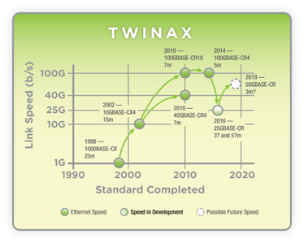
Twinax Copper Roadmap
10G SFP+ Direct Attach is highest attach 10G server port today
40GBASE-CR4 entering the market
Notable interest in 25GBASE-CR for cost optimization
Optimizing single-lane bandwidth (cost/bit) will lead to 50Gb/s

Slide 24
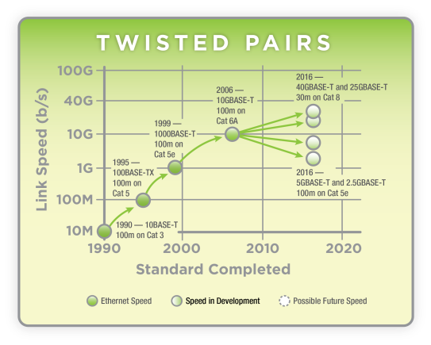
BASE-T Copper Roadmap
1000BASE-T still ~75% of server ports shipped in 2014
Future focus on optimizing for data center and enterprise horizontal spaces

Slide 25
The Applications Spaces of BASE-T
ENTERPRISE FLOOR
Office space, for example
DATA CENTER
1000BASE-T
2.5/5G?
10GBASE-T
Floor or Room-based
5m 30m 100m
Reach
25G?
40G
Row-based (MoR/EoR)
Rack-based (ToR)
Data Rate
Source: George Zimmerman, CME Consulting

Slide 26
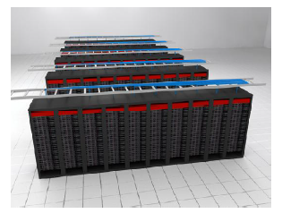
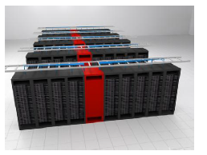
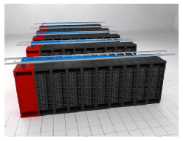
ToR, MoR, EoR Interconnects
Switches
Servers
Interconnects
ToR
MoR
EoR
Intra-rack can be addressed by twinax copper direct attach
Reaches addressed by BASE-T and fiber
Pictures from jimenez_3bq_01_0711.pdf, 802.3bq

Slide 27



802.3 Ethernet and 802.11 Wireless LAN
1000BASE-T
Power over Ethernet
Ethernet Access Switch
Dominated by 1000BASE‐T ports
Power over Ethernet Power Sourcing Equipment (PoE PSE) supporting 15W, 30W, 4PPoE: 60W-90W
Cabling
100m Cat 5e/6/6A installed base.
New installs moving to Cat 6A for 10+yr life.
Wireless Access Point
Mainly connects 802.11 to 802.3
Normally PoE powered
Footprint sensitive (e.g. power, cost, heat, etc.)
Increasing 802.11 radio capability (11ac Wave1 to Wave2) drives Ethernet backhaul traffic beyond 1 Gb/s.
Link Aggregation (Nx1000BASE-T) or 10GBASE-T only options today
Notes:
[PJ] speaker notes.
On this slide I want to talk about how the access layer switches interact with the 802.11 APs.
If I look at a typical enterprise access switch today, it has 24 or 48 downlinks of 10/100/1000BT. It’s often acting as a PoE PSE sending 15 or 30 watts towards the downlink. When the current work for 4 pair poe completes, that power number will jump.
As I said before, enterprise access links are running 1000BASE-T with Poe over Cat 5e or CAT6. New installs looking for 10+years of life are moving towards Cat 6A or above, but that’s showing up in less than 25% of the networks today.
Wireless APs are the standout use case for this CFI. The enterprise A market is dominated by APs that look like this one. They link 802.11 to 802.3, are normally PoE powered, and need a low footprint. By that, I mean that they are very sensitive to cost, power and heat limitations.
The rapid increase in system bandwidth coming with the changes in 802.11ac are driving the APs to and beyond the bandwidth of a single 1000BASE-T link. Today this can only be resolved with link aggregation which requires pulling two cables to the AP, or 10GBASE-T, which needs new CAT6A cable, and has other challenges for the AP builder including power and heat.
To enable simple adoption of the new 11ac wave 2 APs, we need to enable them to use the existing installed cabling.

Slide 28
Implications of 50G serdes on Ethernet speeds
Kapil Shrikhande

Slide 29
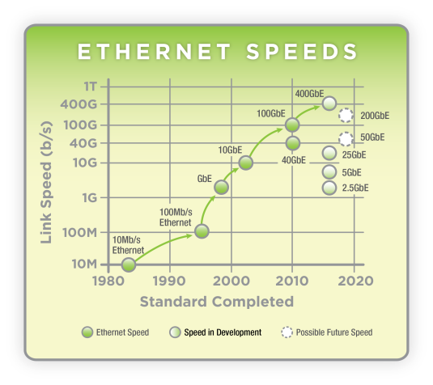
Ethernet Speeds: Observations
Data centers driving speeds differently than Core networking
  40GE (4x10G) not 100G (10x10G) took off in DC network IO
  25GE (not 40GE) becomes next-gen server IO > 10G
  100GE (4x25G) will take off with 25GE servers
    And 50G (2x25G) servers
  What’s beyond 25/100GE? Follow the Serdes ☺
?

Slide 30
SerDes / Signaling, Lanes and Speeds
16x
400GbE
10x
100GbE
8x
400GbE
Lane count
200GbE ?
4x
40GbE
100GbE
2x
50GbE
100GbE
1x
10GbE
25GbE
50GbE ?
10Gb/s
25Gb/s
50Gb/s
Signaling rate

Slide 31
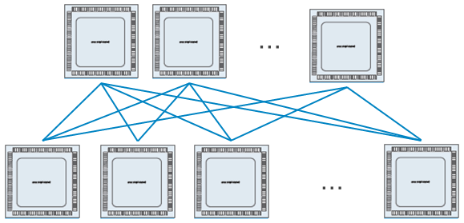

Ethernet ports using 10G SerDes
Data centers widely using 10G servers, 40G Network IO
128x10Gb/s switch ASIC
E.g. TOR configuration
  96x10GE + 8x40GE
128x10GbE
32x40GbE
12x100GbE
Large port count Spine switch
= N*N/2, where N is switch chip radix
N = 32 → <= 512x40GE Spine switch
N=12 → <= 72x100GE Spine switch
High port count of 40GE better suited for DC scale-out

Slide 32
Ethernet ports using 25G SerDes
Data centers poised to use 25G servers, 100G Network IO
128x25Gb/s switch ASIC
E.g. TOR configuration
  96x25GE + 8x100GE
128x25GbE
32x100GbE
Large port count Spine switch
= N*N/2, where N is switch chip radix
N = 32 → <= 512x100GE Spine switch
100GE (4x25G) now matches 40GE in ability to scale

Slide 33
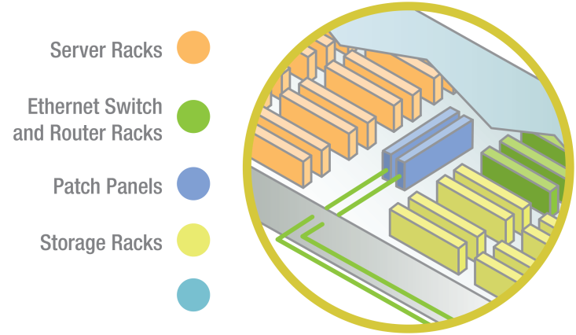
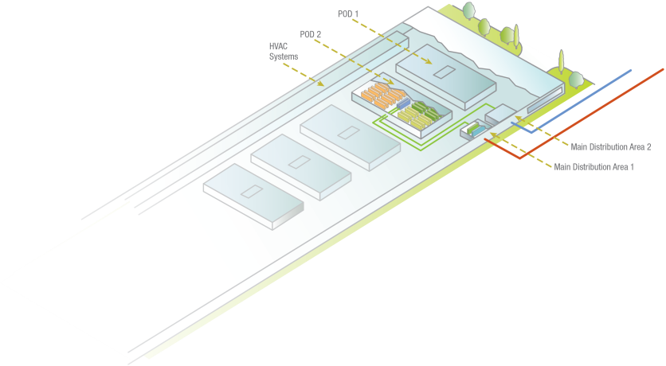
Data-center example
E.g. Hyper-scale Data center
  288 x 40GE Spine switch
  64 Spine switches
  96 x 10GE Servers / Rack
  8 x 40GE ToR Uplinks
  # Racks total ~ 2304
  # Servers total ~ 221,184
Same scale possible with 25GbE servers, 100GE networking
Hyper-scale Data center

Slide 34
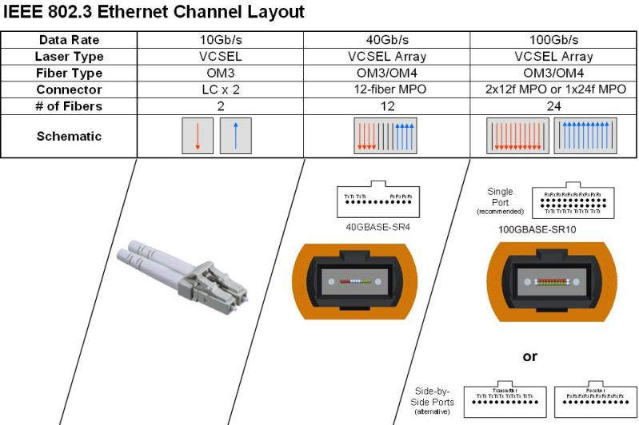
QSFP optics
Data center modules need to support various media types, and reach
QSFP+ evolved to do just that
QSFP28 following suit
4x lanes enabling compact designs
IEEE and MSA specs.
XLPPI, CAUI4 interfaces
Breakout provides backward compatibility
  E.g. 4x10GbE
Duplex
MMF
SMF
100m
2km
10km
40km
Parallel
100m
300m
500m

Slide 35
Evolution using 50G SerDes
Next-gen switch ASIC
50GbE Server I/O
  Single-lane I/O following 10GE and 25GE
200GbE Network I/O
  Balance Switch Radix v. Speed
  Four-lane I/O following 40GE and 100GE
Data center cabling, topology can stay unchanged
  40GE -> 100GbE -> 200GbE
50Gb/s SerDes chip
Radix
n x 40/50GbE
n/2 x 100GbE
n/4 x 200GbE
n/8 x 400GbE
Speed

Slide 36
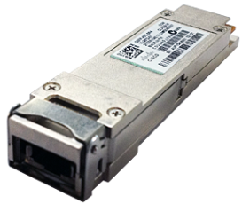
200GE QSFP feasibility
50G-NRZ/PAM4 for SMF, MMF : Yes
Parallel / duplex fibers : Yes
Twin-ax DAC 4 x 50G-PAM4 : Yes
Electrical Connector : Yes
Electrical Signaling specifications : Yes
FEC striped over 4-lanes : Yes, possibly
  Keep option open in 802.3bs
Power, Space, Integration ? Investigate.
  Same questions as with QSFP28 … gets solved over time
For optical engineers – 200GbE allows continued use of Quad designs from 40/100GbE. Boring but doable ☺

Slide 37
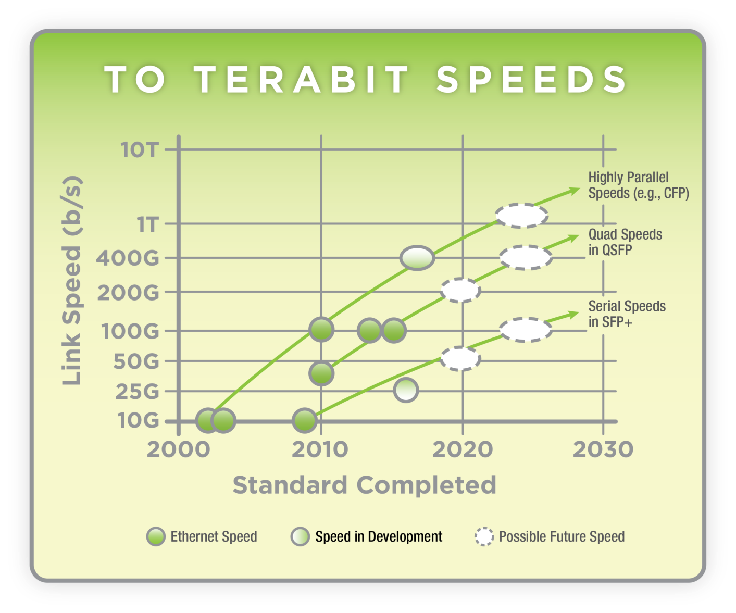
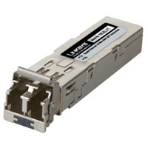
The Ethernet Roadmap
QSFP
400G >2020
200G - ~2019?
100G - 2015
40G - 2010
SFP
100G >2020
50G - ~2019?
25G - 2016
10G - 2009

Slide 38
Questions and Answers

Slide 39
Thank You!

